Slide 1




Engaging Public in Spatial Decisions through Digital Platforms
Ivana Marjanović, University of Niš, Faculty of Economics, Serbia
e-mail: ivana.veselinovic@eknfak.ni.ac.rs

Slide 2



Introduction
Citizen engagement is increasingly acknowledged not merely as a democratic right but as a foundational element of effective and equitable urban development
Cities thrive when residents are actively involved in shaping their environment, as locals best understand community needs and can offer valuable insights into policy performance
This paper investigates the transformative potential of digital platforms to reshape participatory spatial planning by enabling broader and more dynamic citizen involvement
When designed with accessibility, usability, and transparency in mind, digital tools can democratize spatial planning by empowering citizens, particularly underrepresented groups, to actively contribute to territorial debates.

Slide 3
Introduction
From a regional science perspective, there is a strong rationale for embracing participatory digital tools in territorial governance
Digital participation platforms have emerged as promising tools to lower barriers to engagement and involve more citizens in spatial planning processes. Within the broader smart cities discourse, the concept of smart governance underscores using ICT not just for efficiency, but for collaboration and co-governance with citizens.
Smart governance initiatives aim to enrich the relationship between citizens and government by enabling interactive communication, consultation, and partnership
This paper aims to contribute to this emerging area by analyzing how a digital application, City&Me, facilitates citizen involvement in spatial planning decisions, and how its use affects inclusivity, transparency, and trust in local governance. Specifically, we focus on City&Me’s pilot deployment in Niš, examining how the app was used to engage residents in urban park management (a concrete spatial planning issue) and what outcomes and insights resulted

Slide 4
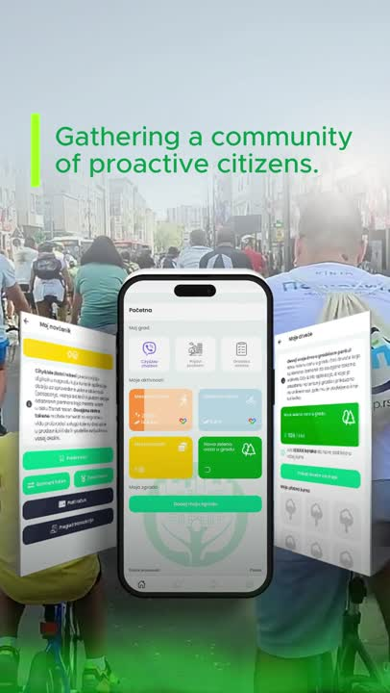
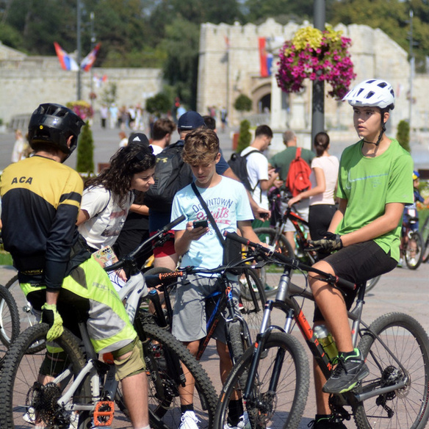
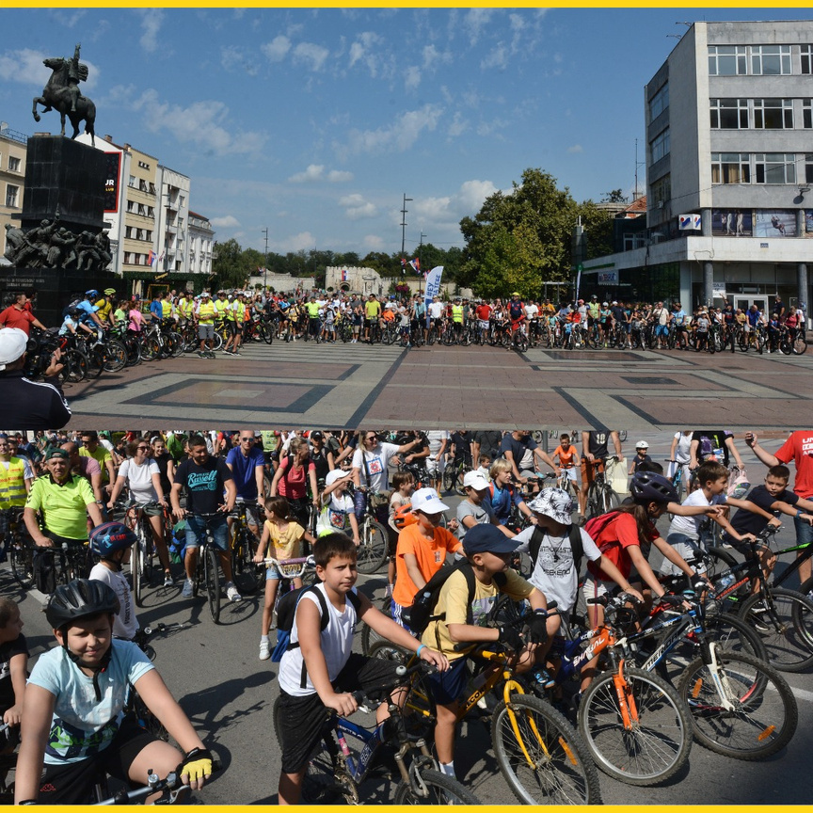
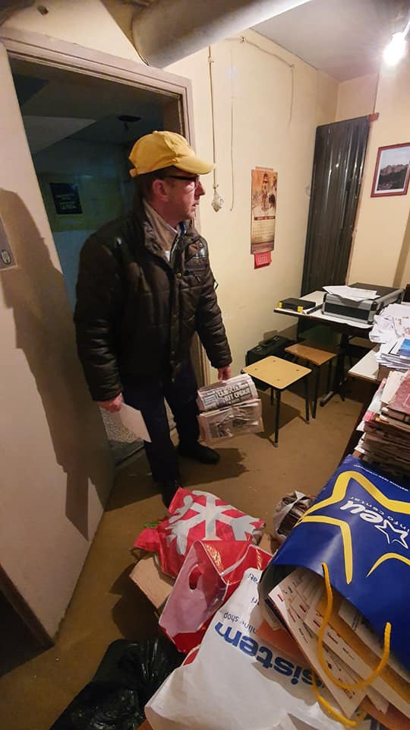
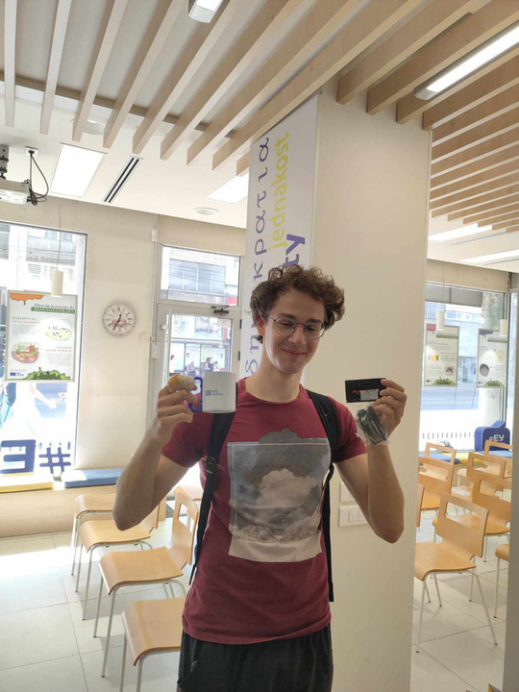
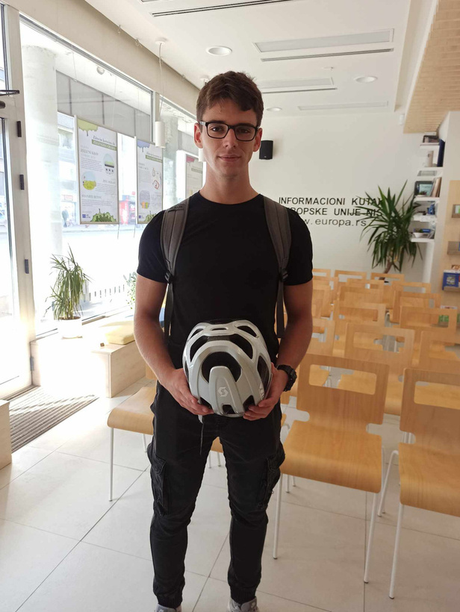
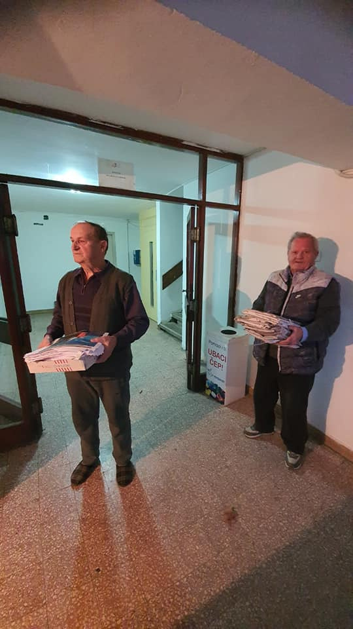
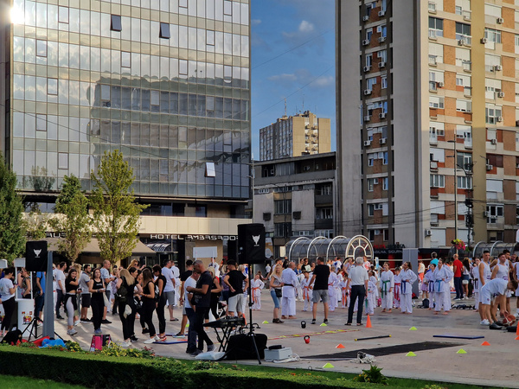
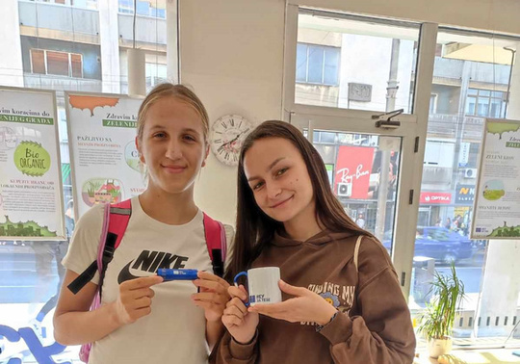
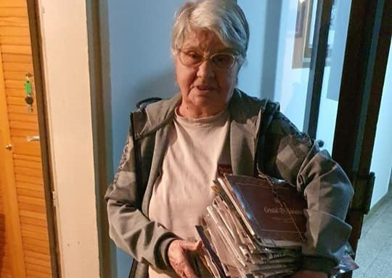
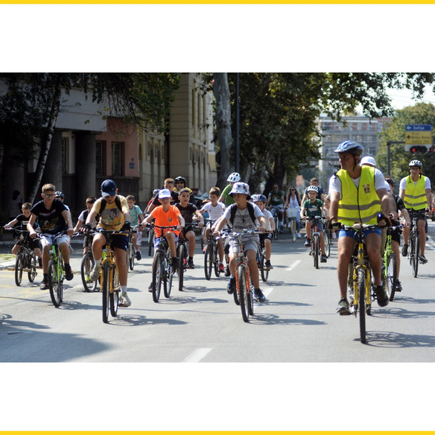
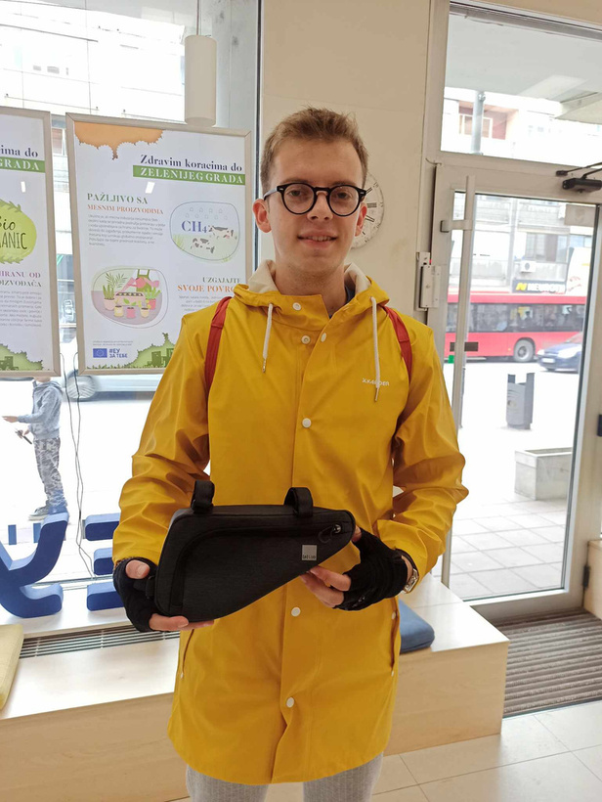
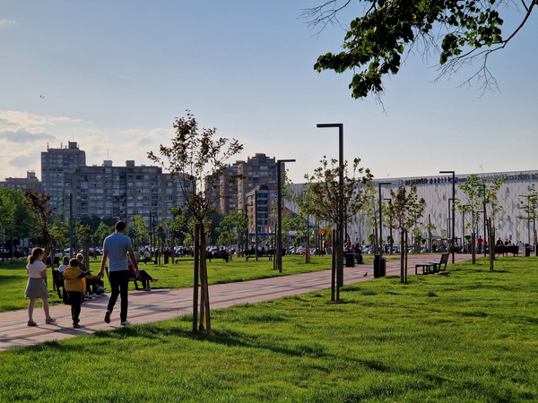

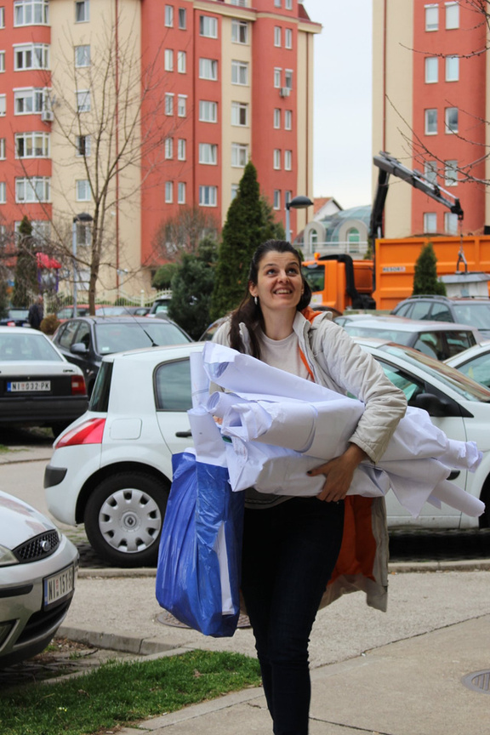

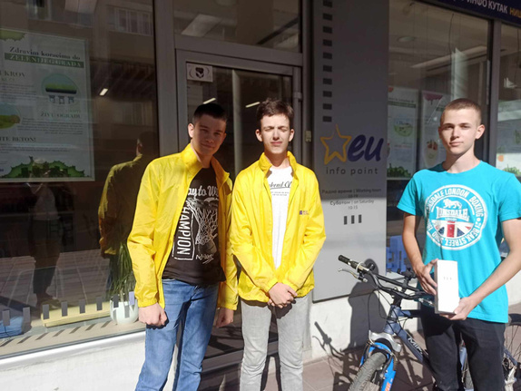

City&Me is a digital platform for interactive and sustainable communities
that links citizens and the city with the aim to foster a sense of community
and allow people to be connected to the city they live in.

Slide 5

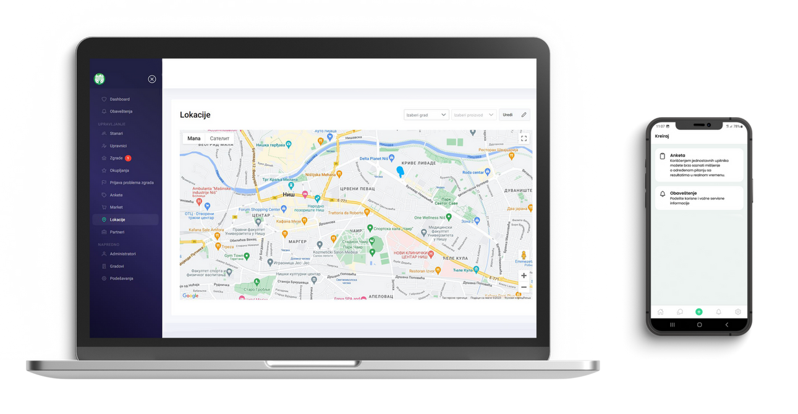
City&Me for cities
01
Two-way communication
between the city and Its citizens
02
Conducting polls, voting and
decision-making at the local level
03
Managing reported problems
and communal issues
04
Rewarding program for citizens
based on city token system
05
Relevant statistical data monitoring
based on citizens’ activities

Slide 6
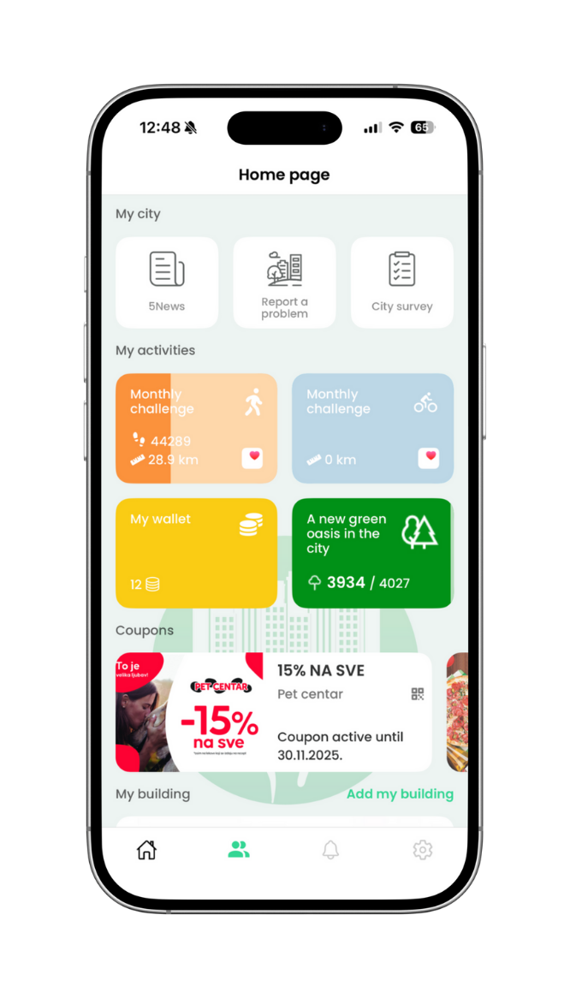

City&Me for citizens
01
Participation in decision-making at the building level or local community level
02
Easy problem reporting, clear two-way communication and information
03
Rewarding tokens for “green activities” such as walking, cycling and recycling
04
Token exchange for vouchers, coupons, as well as purchases within the app
05
Payment of communal costs and costs od living within the app
06
Trees in digital urban forest

Slide 7
Methodology and data
An exploratory case study approach focused on the City&Me application.
Developed as a civic tech initiative, its goal is to make municipalities more connected with their residents by encouraging grassroots input in identifying and solving community issues.
City&Me incorporates trust-building mechanisms such as blockchain-based verification of user inputs, aiming to ensure transparency and data integrity in the participation process
For the purposes of this study, a specific participatory initiative was examined: a City&Me-facilitated urban parks survey. The survey was co-designed by the City&Me team and urban planners from Niš to assess residents’ perceptions of the current condition and quality of city parks, and to gather input on potential improvements

Slide 8
Methodology and data
The City&Me urban parks survey was open for one week (March 12–19, 2025) and was accessible to all registered users of the app residing in Niš. In essence, the invitation to participate was city-wide among the app’s user base, making it a near-census of engaged citizens. As of early 2025, approximately 15% of Niš’s population were registered on City&Me.
All these users received in-app notifications about the survey. Participation was entirely voluntary, but the broad invitation aimed to maximize inclusivity and reach diverse demographic segments (young and old, various neighborhoods, etc.) who use the app.
Notably, this approach differs from traditional surveys that rely on sampling; instead, it seeks to hear from any and all interested citizens, aligning with the ethos of inclusive governance.

Slide 9
Results and discussion
The City&Me urban parks survey saw a robust response from Niš residents, indicating a high level of public interest in contributing to spatial decisions via the digital platform.
Out of all invited app users, approximately 7.1% participated in the survey. In absolute terms, 1,231 citizens submitted responses over the one-week period. This response rate is notable for a voluntary digital engagement initiative. According to City&Me’s records, the turnout surpassed the average participation seen in previous in-app surveys by roughly 16%.
The above-average engagement may also reflect growing adoption and trust in the platform itself, as this initiative occurred after several months of City&Me usage in Niš

Slide 10
Results and discussion
Demographic Category | Percentage of Respondents
Gender
Women | 56%
Men | 44%
Age Group
18–24 years | 24.4%
25–35 years | 33.0%
35–44 years | 21.3%
45–54 years | 14.2%
55+ years | ~7.1%
The participation data suggest that City&Me succeeded in mobilizing a diverse cross-section of the public – particularly drawing in groups (like 18–34 year-olds) who are traditionally harder to reach through conventional public meetings. However, it also points to the need for strategies to engage older citizens to ensure truly comprehensive spatial governance

Slide 11
Citizen Priorities for Park Improvements
Improved Cleanliness and Maintenance (320 votes): The top priority for residents was better upkeep of parks. This includes more frequent trash collection and litter removal, regular cleaning of green areas, and prompt repairs of broken park infrastructure (such as benches, play equipment, or pathways).
Increased Greenery and Aesthetics (302 votes): A close second priority was enhancing the natural environment and beauty of the parks. Citizens would like to see more trees planted, flower beds or gardens added, and overall better landscaping. This suggests that residents value parks not only as recreational spaces but also as green oases in the urban fabric.

Slide 12
Citizen Priorities for Park Improvements
Maintenance of Existing Amenities (283 votes): Apart from general cleanliness, respondents specifically highlighted the need to take care of park amenities like benches, playgrounds, fountains, and restrooms. Many felt that existing facilities were in disrepair – for instance, broken benches or malfunctioning playground equipment – and that fixing these should be a priority before adding new features. This response underscores a pragmatic approach among citizens: invest in preserving and restoring what the city already has.
Enhanced Lighting and Security (174 votes): A significant number of participants expressed concerns about safety in the parks, especially after dusk. They advocated for better lighting and security measures. Specifically, suggestions included installing additional streetlights or solar-powered lights along park paths, and implementing occasional security patrols or surveillance cameras to deter vandalism and illicit activities.

Slide 13
Citizen Priorities for Park Improvements
New Amenities and Facilities (152 votes): A smaller but notable group of respondents called for introducing new features in the parks, such as dedicated dog parks, improved playgrounds, or recreational facilities. Young families and adults in the 25–35 age range were especially likely to suggest more child-friendly infrastructure (swings, slides, safe play areas) and outdoor fitness equipment or sports courts for exercise. Although this category received fewer votes compared to basics like cleanliness, it highlights an appetite for diversifying park usage and making parks more attractive destinations for all age groups.

Slide 14
Conclusion
The Niš City&Me case study offers compelling evidence of how digital platforms can transform citizen engagement in spatial decision-making, aligning with many of the expectations derived from the literature. The results illustrate that when provided with an accessible, trustworthy tool, citizens are not only willing but in fact eager to participate in governance processes that affect their local environment.
The City&Me case exemplifies the principle of “serving rather than steering”. Niš’s administration, by partnering with City&Me and the Urban Planning Institute, effectively served the public by enabling them to articulate their needs and preferences, rather than unilaterally deciding what the parks require.

Slide 15
Conclusion
Limitations and challenges
  Digital Divide and Inclusivity: As noted, older residents and possibly those less affluent (though we did not collect income data, smartphone-based participation inherently might exclude those without internet access) were underrepresented
  Managing Expectations and Ensuring Follow-through: High engagement and clear results now put the focus on local authorities to act on the input
Future research directions: a deeper qualitative understanding of citizens’ experiences of trust in digital participation is needed. While we inferred trust from behavior and simple feedback, interviewing participants or conducting focus groups would enrich our understanding. Questions such as “What motivates a citizen to use the app?” or “How do they perceive the city’s responsiveness?” could be explored

Slide 16
Thank You!
www.urwise.net

