Slide 1




Citizen-Centered Efficiency Assessment of European Smart Cities: A DEA Perspective
Ivana Marjanović, Jelena Stanković
University of Niš, Faculty of Economics, Serbia
e-mail: ivana.veselinovic@eknfak.ni.ac.rs

Slide 2



Introduction
Urbanization challenges cities to balance technological progress with social sustainability.
Accelerated urbanization → economic, social, environmental pressures.
Smart city concept integrates ICT, innovation, and governance.
Beyond infrastructure: inclusiveness, quality of life, equity.
Efficiency is key: How well do cities convert resources into outcomes?
This paper applies Data Envelopment Analysis (DEA) to assess the efficiency of European smart cities. DEA benchmarks cities in terms of transforming resources into socially sustainable outcomes, highlighting leaders, laggards, and opportunities for policy improvements.

Slide 3
Literature Review
Smart city frameworks: people, economy, governance, mobility, environment, living.
Rankings (e.g., European Smart Cities Index, Green City Index).
Existing approaches emphasize infrastructure & technology.
Limited focus on social efficiency & inclusiveness.
DEA offers comparative benchmarking for efficiency assessment.

Slide 4
Methodology
Approach: Data Envelopment Analysis (DEA).
Developed by Charnes, Cooper & Rhodes (1978) as an extension of Farrell’s (1957) efficiency measurement framework.
Designed to handle multiple inputs and multiple outputs simultaneously, unlike traditional ratio-based efficiency measures.
Non-parametric approach: DEA does not assume a functional form of the production function.
Based on linear programming, constructing a piecewise linear “efficient frontier” from observed data. Units achieving the frontier are considered efficient (score = 1), while others are compared relative to them.
Efficiency is defined as the ability to maximize outputs given inputs (output-oriented) or minimize inputs for given outputs (input-oriented).
DEA defines efficient frontier and relative inefficiency.
Benchmarking reveals leaders and improvement potentials.

Slide 5
Data
• Source: Eurostat Urban Audit.
• Coverage: 2023, last survey cycle.
• Sample: 80 European cities across regions.
• Indicators grouped into six dimensions:
– Infrastructure
– Living
– Environment
– Employment & Finance
– Governance
– People

Slide 6
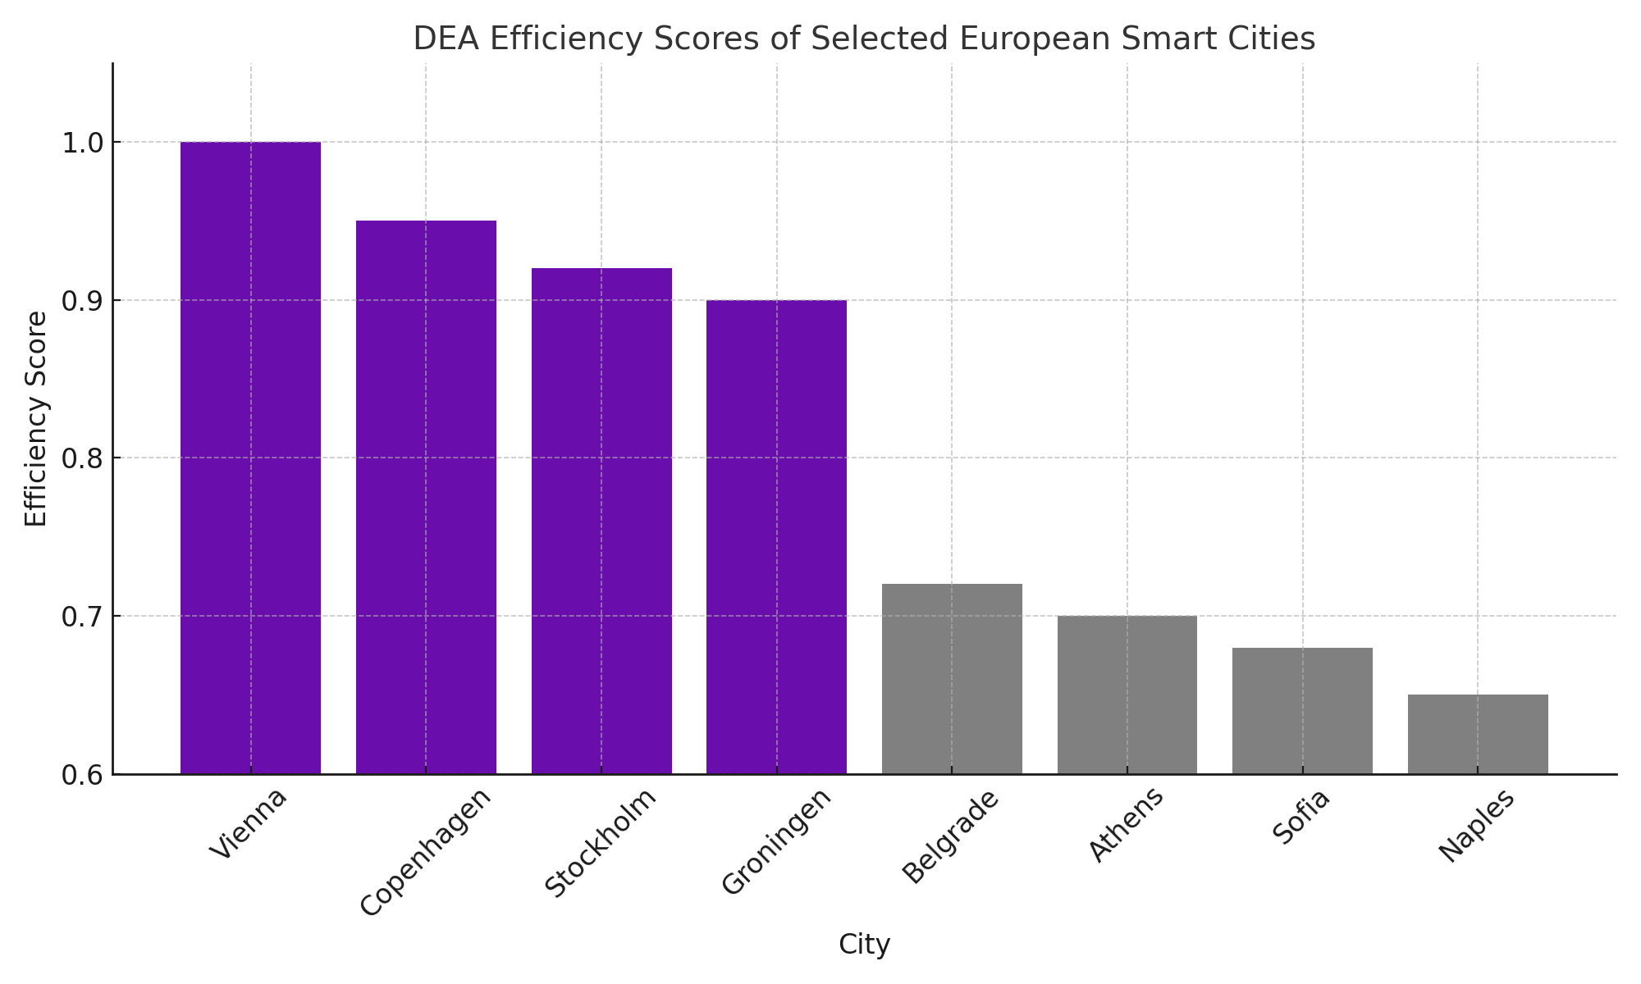
Results
DEA identifies efficient cities: Vienna, Copenhagen, Stockholm, Groningen.
Many Western/Northern cities on frontier, Southern/Eastern lag behind.
Efficiency gaps highlight uneven capacity to transform resources.
Benchmarking illustrates practical guidance for lagging cities.
Cities differ not only in resources but in governance quality and citizen inclusion.

Slide 7
Discussion
DEA confirms efficiency as critical for smart city success.
Social sustainability needs more than infrastructure.
Younger and innovative cities adapt better to challenges.
Importance of governance, equity, citizen participation.
Continuous monitoring essential for balanced development.

Slide 8
Policy Implications
Develop EU-wide frameworks for socially sustainable cities.
Balance technological and social investments.
Foster citizen engagement platforms.
Reduce regional disparities via knowledge transfer.
Apply DEA results to prioritize reforms and allocate resources.

Slide 9
Conclusion
DEA provides robust benchmarking of smart city efficiency.
Efficiency gaps highlight regional inequalities.
Leaders demonstrate good practices in governance & participation.
Results support socially sustainable smart city strategies.
Future: Extend DEA with qualitative case studies and dynamic models.

Slide 10
Thank You!
www.urwise.net

